Slide 1
Active learning & Convex set and convex function
田鹏超
tianpch@shanghaitech.edu.cn

Slide 2
Active Learning

Slide 3
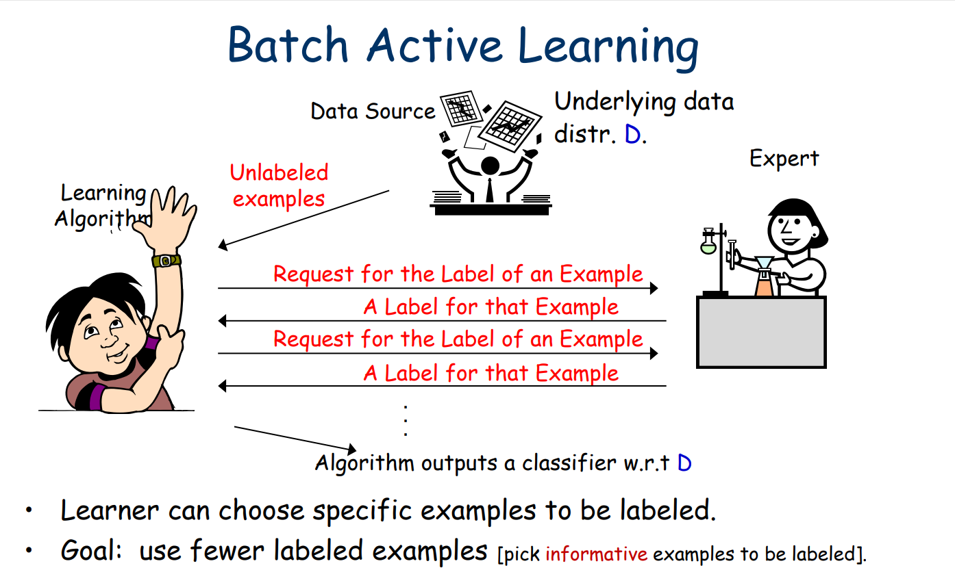
Introduction

Slide 4
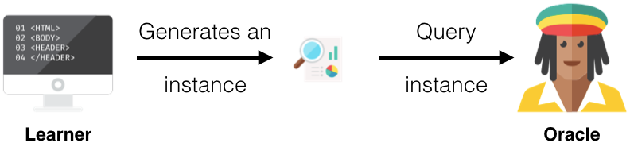
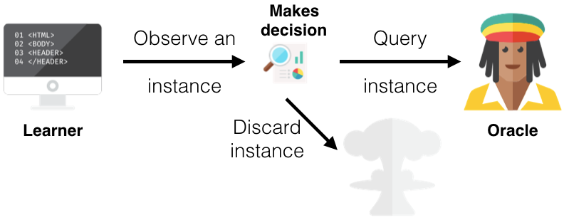
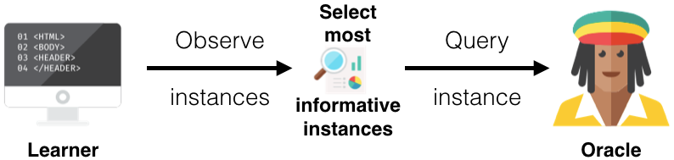

Slide 5
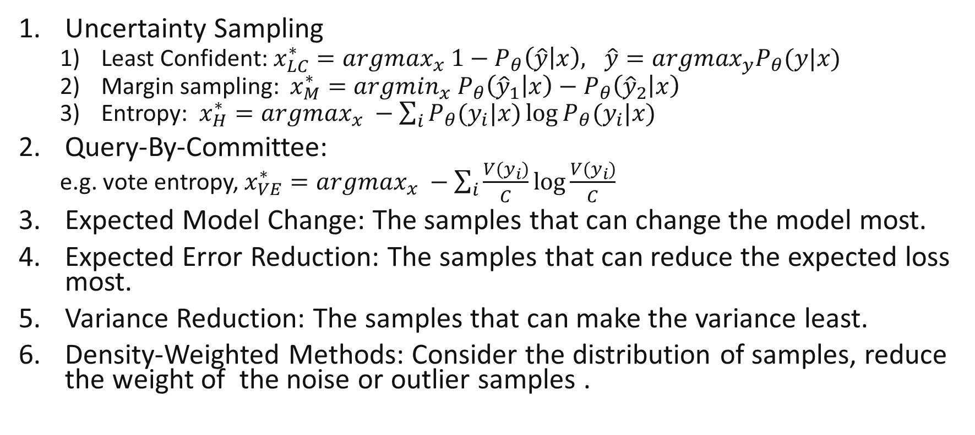
Query Strategy Framework
Uncertainty Sampling
Least Confident: $x_{LC}^{∗}={argmax}_{x} 1−P_{θ}\left(\hat{y} | x\right), \hat{y}={argmax}_{y}P_{θ}(y|x)$
Margin sampling: $x_{M}^{∗}={argmin}_{x} P_{θ}\left({\hat{y}}_{1} | x\right)−P_{θ}\left({\hat{y}}_{2} | x\right)$
Entropy: $x_{H}^{∗}={argmax}_{x} −\sum_{i}{P_{θ}(y_{i}|x)\log{P_{θ}(y_{i}|x)}}$
Query-By-Committee:
e.g. vote entropy, $x_{VE}^{∗}={argmax}_{x} −\sum_{i}{\frac{V(y_{i})}{C}\log{\frac{V(y_{i})}{C}}}$
Expected Model Change: The samples that can change the model most.
Expected Error Reduction: The samples that can reduce the expected loss most.
Variance Reduction: The samples that can make the variance least.
Density-Weighted Methods: Consider the distribution of samples, reduce the weight of the noise or outlier samples .

Slide 6
Reference
Active learning (machine learning) – Wikipedia
A Beginner's Guide to Active Learning – DataCamp
Active Learning | Medium

Slide 7
Convex set and convex function

Slide 8
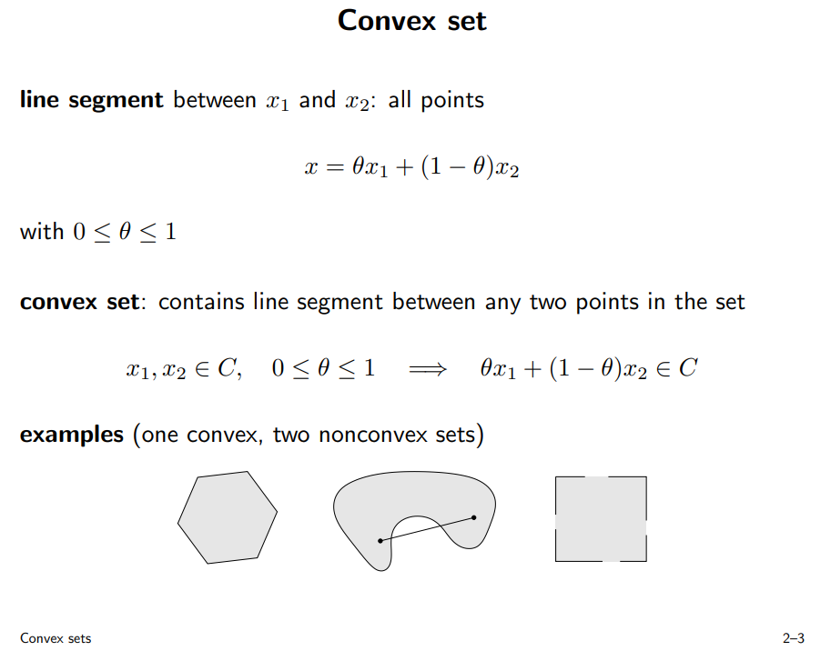

Slide 9

Exercise 1
Show that if $S_{1}$ and $S_{2}$ are convex sets in $R^{m×n}$, then so is their partial sum:
$$S=\{(x,y_{1}+y_{2})|x∈R^{m},y_{1},y_{2}∈R^{n},(x,y_{1})∈S_{1},(x,y_{2})∈S_{2}\}$$

Slide 10
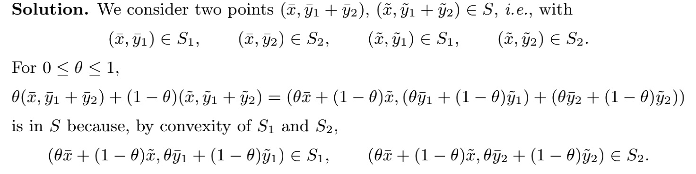
Exercise 1

Slide 11
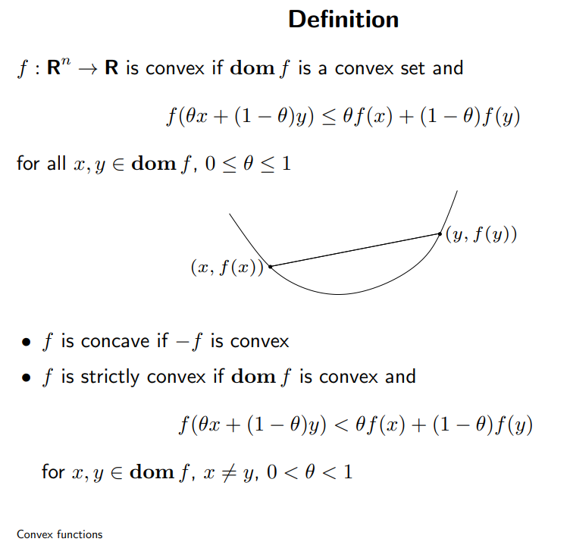
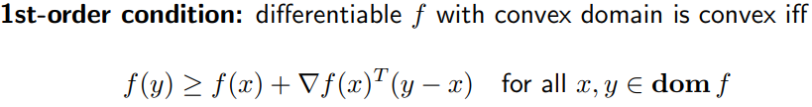
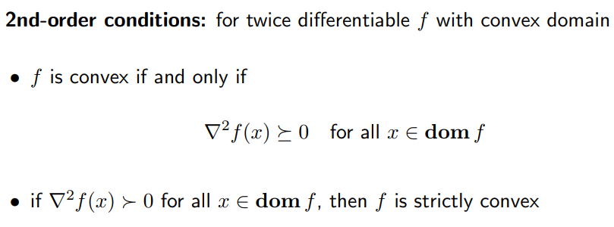
Convex functions

Slide 12

Exercise 2
Descirbe the concavity and convexity of $f(x)$ over its domain $R$?
$$f\left(x\right)=5x^{3}−81x^{2}+11x+97$$

Slide 13
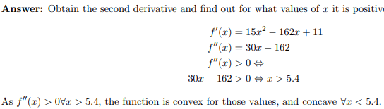
Exercise 2

